Slide 1
Sentiment Analysis on Movie Review
DEPARTMENT OF COMPUTER ENGINEERING AND APPLICATIONS
Presented by
Vivek Goyal(181500817)
Prachi Bansal(181500459)
Mani Bansal(1815100364)
Himanshi Agrawal(181500267)
Supervised By:
Mr. Navin Kumar Agrawal

Slide 2
SENTIMENT ANALYSIS
Sentiment relates to the meaning of a word or sequence of words and is usually associated with an opinion or emotion.
Sentiment analysis (also known as opinion mining) refers to the use of natural language processing, text analysis to identify and extract subjective information in source materials.
Consumers can use sentiment analysis to research products and services before a purchase. Production companies can use the public opinion to determine acceptance of their products and the public demand.
Movie-goers can decide whether to watch a movie or not after going through other people’s reviews.

Slide 3
MOTIVATION

Slide 4
PRE-PROCESSING
All reviews were converted to lower case.
All links and urls were replaced by generic word URL
All usernames were replaced by generic word USER
Words with hashtags were replaced with the same
words without the hashtag
Punctuations and additional white spaces were removed from the reviews.
All the above work was done in python via regular expression matching. The code for preprocessing will be uploaded along with the main code.

Slide 5
ALGORITHM USED
The algorithm on which the proposed system is built is the Naive Bayes Classifier Algorithm.
Naive Bayes algorithm is a supervised learning algorithm, which is based on Bayes theorem and used for solving classification problems.
It is one of the simple and most effective Classification algorithms which is mainly used in text classification.

Slide 6
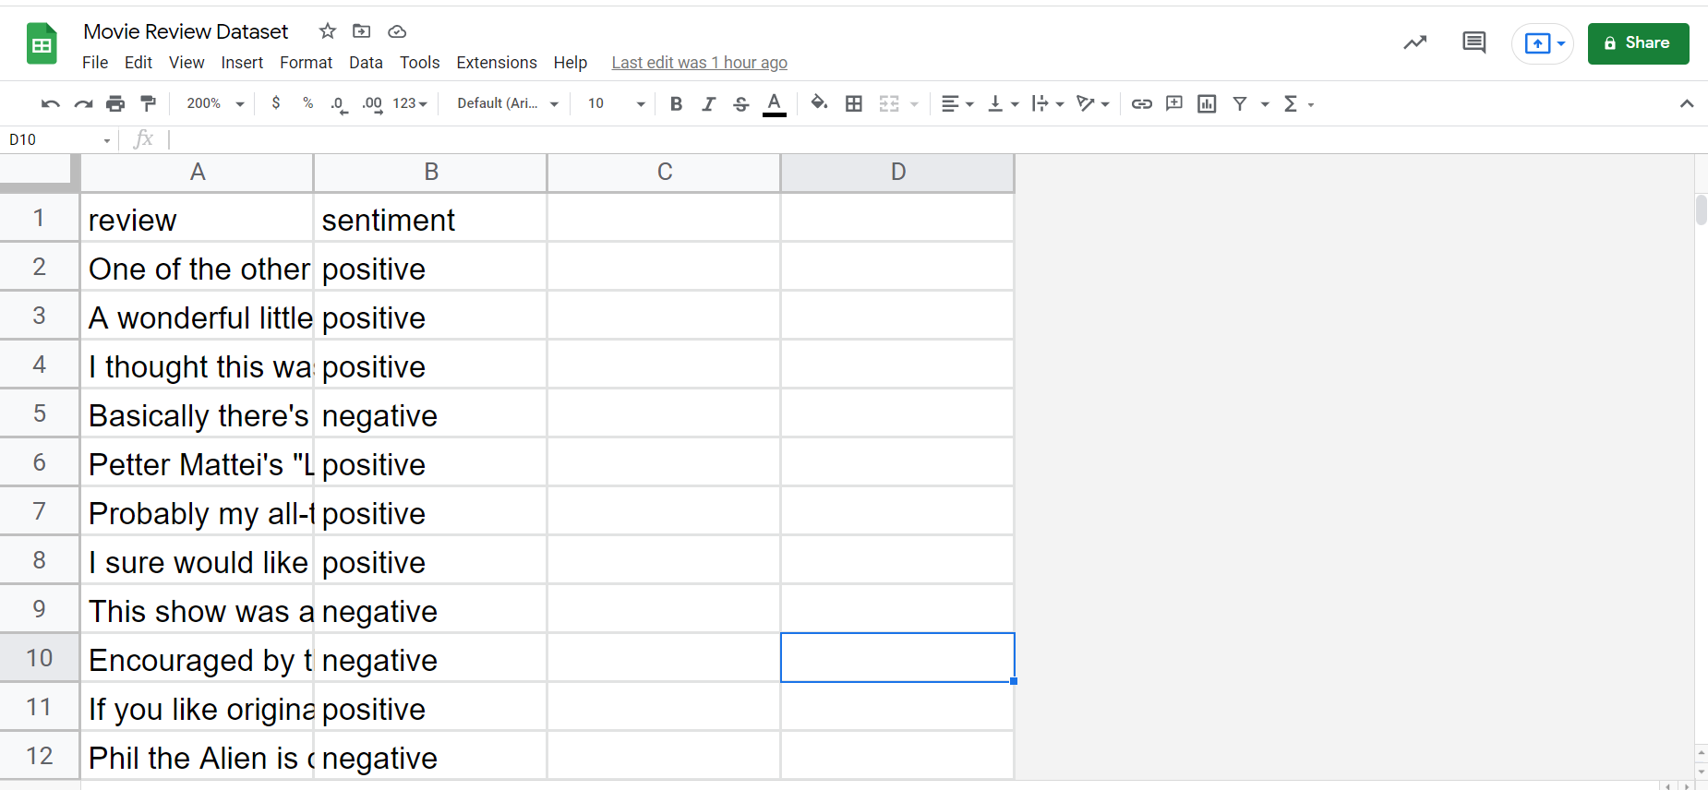
DATASET USED
(Movie Review Dataset)

Slide 7
IMPLEMENTATION ON TRAINING AND TESTING DATASET
GET THE DATA
DISCOVERY AND VISUALIZATION ON DATA
PERFORMING THE LABEL ENCODING
IMPLEMENTING ML ALGORITHM
ACCURACY ON TRAINING DATASET
ACCURACY ON TESTING DATASET

Slide 8

MAIN PAGE

Slide 9
RESULT ANALYSIS
From the analysis of the model, the Logistic Algorithm proved to be the best suitable algorithm for the system.
This model is trained to predict that the review for the movie is positive or negative based on the basis of the user input for the trained features.
The predicted outcome or result was found to give an accuracy of around 0.94 (94%).

Slide 10
THANK YOU

